Slide 1


HEALT INSURANCE COST PREDICTION
HEALTH INSURANCE COST PREDICTION

Slide 2
PROJECT DONE BY
MITHUN SINGH
RAJYA LAKSHMI
M CHAITANAY NAIDU

Slide 3
Health Insurance Cost Prediction using Machine Learning
Abstract
Insurance is a policy that helps to cover up all loss or decrease loss in terms of expenses incurred by various risks.
These considerations of different factors contribute to the insurance policy cost expression. Machine Learning( ML) in the insurance sector can make insurance more effective.
ML is one of the computational intelligence aspects when it comes to exploitation of historical data that may be addressed in a wide range of applications and systems.
Using the machine learning algorithms, this study provides a computational intelligence approach for predicting healthcare insurance costs.
The proposed research approach uses Linear Regression, Decision Tree Regression and Gradient Boosting Regression and also streamlet as a framework.
The machine learning methods are used to show the forecasting of insurance costs by regression model comparing their accuracies.

Slide 4
INTRODUCTION
Machine learning is the process of learning from data and converting that data into information.
It is also a tool for solving a variety of problems. Additionally, machine learning is creating computational art forms that improve with time and via experience. Statistics, philosophy, fact theory, psychology, and neurology are all included in the multidisciplinary field of machine learning. This research project studies various algorithms to show how machine learning can be used to better understand pricing and risk assessment, for instance, machine learning algorithms can be used to find and examine trends in massive datasets .Additionally, it studies algorithms that demonstrate how machine learning can be used to detect fraudulent claims and study consumer behavior to improve customer service and save expenses. Finally, it studies how machine learning can be used to construct predictive models to estimate future trends in the insurance sector, such as client demand and market changes. Nowadays, the manner that insurance companies conduct their business is modified or altered by machine learning algorithms. The insurance industry was founded with the goal of anticipating or forecasting

Slide 5
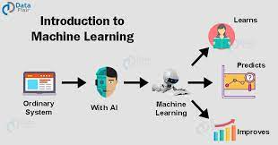

Slide 6
DATASET
We had used a dataset from Kaggle Site for creating our prediction model. This data set includes nine attributes and the data set has spitted into two-parts : training data and testing data. For training the model, 80% of total data is used and the rest for testing. To build a predictor model of medical insurance cost the training dataset is applied and to evaluate the regression model, test set is used. The following table shows the Description of the Dataset

Slide 7
Table I.
Name | Description
Age | Age of client
BMI | Body mass index
No. of kids | Number of children the client have
gender | Male / Female gender
Smoker | Whether a client is a smoker or notWhether a client is a smoker or not
Alcoholic | Whether a client is drinks alcohol or not
Diabetic | Whether a client is having diabetes or not
region | Whether the client lives in southwest, northwest, southeast or northeast
Charges(Target Variable) | Medical Cost the client pay
Dataset overview

Slide 8
. DATA PREPROCESSING
DATA PREPROCESSING The dataset includes nine variables, as shown in table 1 From these variables each one of these attributes has some contribution to estimate the cost of the insurance, which is our dependent variable. In this stage, the data is scrutinized and updated properly to efficiently apply the data to the ML algorithms. Now the categorical variables are converted into numeric or binary values to represent either 0 or 1. For example, instead of "SEX" with males or females, the "Male" variable would be considered as false (0) if the person is male. And "female" would be (1) see table II; following this phase now, we can apply this data to all regression models used in this study.

Slide 9
Table II: categorical variables after translated into numeric or binary values
Name | Description
Age | Age of client Age of client
BMI | Body mass index
No. of kids | Number of children the client have
gender | Male / Female 0=Male 1=Female
Smoker | Whether or not a client smokest 0=yes 1=no
Alcoholic | Whether a client drinks alcohol or not 0=yes
Diabetic | Whether a client is having diabetes or not 0=yes 1=no
region | Whether the client lives in southwest, northwest, southeast or northeast 0=southeast 1=southwest 2=northeast 3=northwest
Charges(Target Variable) | Medical Cost the client pay

Slide 10
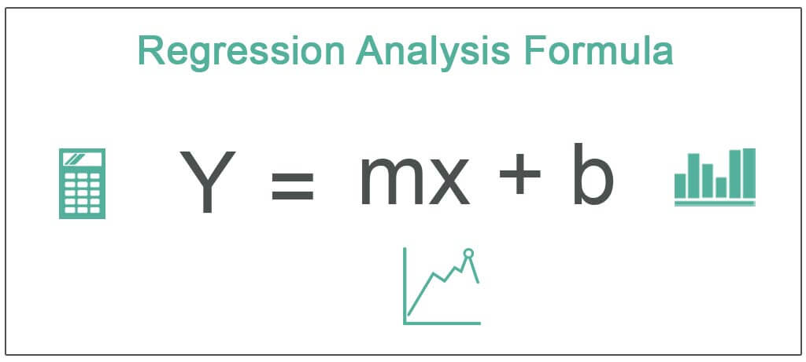
B. Regression
The multivariate analysis may be a prognostic technique that explores the link between a dependent (target) and also the freelance variable
This technology is employed to forecast, estimate model time series, and realize the causative impact relationship among the variables
During this analysis, for example, I need to investigate the relationship between insurance price (target variable) and 6 independent variables supported (age, BMI, kid number, individual living area, or sex and whether or not the client is a smoking person).
on the idea of a regression. The multivariate analysis estimates the connection between 2 or a lot of variables, as declared previously.
We used completely different regression models to estimate insurance prices on the premise of six freelance variables, and by exploiting this regression
we are able to forecast future health insurance fees supported by current and past data
There are many blessings of using regression analysis as follows:
It demonstrates the essential relationships between the dependent and experimental variables
2) It shows the result intensity on the variable quantity of many freelance variables
Analysis of regression conjointly helps one to match the results of measured variables at varied scales, comparable to independent variable and dependent variable effect
hese blessings permit market researchers, knowledge analysts, and data scientists to get rid of and verify the most effective variety of variables for prophetical models

Slide 11
RELATED WORKS Literature Review
The existing related research that has been carried out by various researchers over the years was described in this section. This includes information on general insurance policies, forecasting medical insurance claims, machine learning techniques, data mining, big data, and data science. This section has also examined the tools, methodologies, strategies, data sets, a number of cases, qualities, and weaknesses for each stage of the prior research.
As it gives recent proof of the applications of numerous sectors significantly contribute to giving analysts or researchers in business analytics, predictive analytics, and decision tree substantial inputs .Their work placed a lot of emphasis on predictive analytics, a branch of business analytics that examines the application of input data, statistical combinations, and intelligence machine learning statistics on predicting the plausibility of a specific event occurring, forecasting future trends or outcomes using on-hand data with the ultimate goal of enhancing the performance of the corporation. Predictive analytics, though it has been around for a while, really came into its own in the latter half of the 20th century. Data mining and big data analytics are part of this method
According to their research, business analytics and its use in predictive analytics are well-established methodologies to collect and forecast useful inputs and produce insightful knowledge. This evaluation is crucial since it offers important guidelines for writers who want to comprehend predictive analytics, particularly users of decision trees.
In discusses the basic market drivers that are influencing the adoption of AI and ML and present both conventional and cutting-edge approaches to accurately anticipate insurance claims fraud. The research emphasizes the application of blockchain technology to the prevention and detection of insurance fraud. The research emphasizes the application of blockchain technology to the prevention and detection of insurance fraud. According to published research, predictive accuracy is highly impacted by the quantity and quality of data. Insurance businesses should investigate the advantages of seasoned experts in the field and create original company strategies and regulations. Using exploratory data analysis (EDA) and feature selection methods

Slide 12
REGRESSION MODELS
A. Multiple Linear Regression.
Multiple regression may be an applied mathematics technique which will be wont to analyze the link between one variable and a number of other freelance variables. For example, with the information set utilized in this study, we might need to grasp independent variables (8 independent variables), (linearly) involving the dependent variable (charges). is} mentioned because of the multiple simple regression (MLR) model. associate degree MLR model with t\ independent options and Y results can be calculated as within the following equation In the higher than equation, u is that the residual regression whereas ἀ is the weight of every independent variable or parameter assigned.
B. Decision trees
DTs are straightforward, terribly popular, fast-training, and straightforward to scan models with comparative or different strategies of learning from the data. they're fairly competent however prone to overfitting in their predictions. they'll be strong by their performance .
C. Gradient Boosting Regression
Gradient boosting algorithmic program is one among the foremost powerful algorithms within the field of machine learning. As we all know that the errors in machine learning algorithms are generally classified into 2 classes i.e. Bias Error and Variance Error. As gradient boosting is one of the boosting algorithms it's accustomed to minimize bias error of the model [7]. Gradient boosting algorithms are often used for predicting not solely continuous target variables as a regression however additionally categorical target variables (as a Classifier). Once it is used as a regressor, the price operates as Mean square. Error (MSE) and when it is used as a classifier then the price operates as Log loss

Slide 13
Table 3: model performance Algorithm
RESULT AND DISCUSSION
Used R2 Score Linear Regression | 74.4738141
Decision Tree Regression | 69.0465611
Gradient Boosting Regression | 86.8600199

Slide 14
CONCLUSION
The research uses various machine learning regression models to forecast charges of health insurance based on specific attributes, on medical cost personal dataset from Kaggle.com. The findings are summarized in Table 3. shows that Gradient Boosting offers the best efficiency, with an accuracy of 86.86.Gradient boosting can therefore be used in the estimation of insurance costs with better performance than other regression models. Forecasting insurance prices supported sure factors facilitate insurance suppliers to draw in customers and save time in formulating plans for each individual. Machine learning can considerably minimize these individual efforts in policymaking, as metric capacity unit models can do cost calculation in a very short time, whereas somebody's being would be taking a protracted time to perform constant tasks. This may help businesses improve their profitability. The metric capacity unit models can even manage monumental amounts of dat

Slide 15
THANK YOU

